Slide 1
Plasmid phylodynamics
14/05/2024

Slide 2
Reference chromosome + plasmids – Shigella sonnei
Chr
Chr – Ss046
Standard ref - 4,925,265 bp
Plasmids
Virulence - 214,396 bp
spA – 8,401 bp
spB - 5,153 bp
spC – 2,101 bp
Part of core genome. Should co-evolve with chromosome. Essential virulence determinants. Often lost in culture. Rep type – IncFIA. predicted_mobility – conjugative
VP
small AMR plasmid – lineage 3. Rep type – non detected. predicted_mobility – mobilizable
spA
small plasmid – circularises in assemblies Rep type – non detected. predicted_mobility – mobilizable
spB
small plasmid – circularises in assemblies. Similar in other shigella species (Boydii) Rep type – Col(BS512). predicted_mobility – non-mobilizable
spC

Slide 3
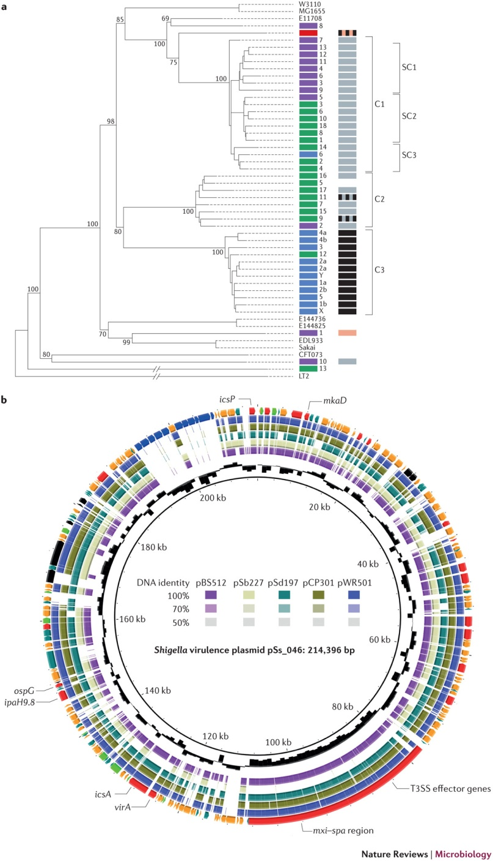
Reference chromosome + plasmids – Shigella flexneri
flexneri – more diverse than sonnei.
Serotype 6 – very distinct lineage
Chr – flex 2a str301
Standard ref – 4,607,202 bp
Plasmid
Virulence - 221,618 bp
Chr
Part of core genome. Should co-evolve with chromosome. Essential virulence determinants. Rep type – IncFIA. predicted_mobility – mobilizable
VP
Notes:
A neighbour-joining phylogenetic tree generated by sequencing 23 chromosomal genes²⁷. Strains are labelled by serotype and coloured by species: Shigella sonnei in red, Shigella flexneri in blue, Shigella boydii in green and Shigella dysenteriae in purple; Escherichia coli isolates are uncoloured. Bootstrap values of >50% are indicated at the major nodes, and the three major Shigella genus clusters (C) and subclusters (SC) are indicated. The carriage of the two specific isoforms of virulence plasmids is additionally indicated in the second column of coloured blocks: pINV A (grey), pINV B (black), either pINV A or pINV B (hatched black and grey), a unique form of pINV (pink), and either pINV B or a unique isoform (hatched black and pink). b | A comparative gene map of the Shigella virulence plasmid, using the S. sonnei virulence plasmid pSs_046 as a reference; the innermost ring represents pSs_046, with coordinates. The second ring (black) shows the GC content of the reference pSs_046 sequence. The following purple, pale green, teal, khaki, and blue rings show BLASTN comparisons between pSs_046 and the virulence plasmids of S. boydii str. BS512, S. boydii str. Sb227, S. dysenteriae str. Sd197, S. flexneri F2a str. 301 (pCP301) and S. flexneri F5a (pWR501), respectively. The outer ring represents annotations of genes or genetic clusters based on function: known virulence factor genes (red); plasmid replication, transfer and maintenance genes (black); transposon, phage-borne and insertion sequence elements (orange); genes encoding hypothetical proteins (teal); the S. sonnei-specific O antigen biosynthesis cluster (blue); and genes encoding proteins with other known functions (green). ipa, invasion plasmid antigen gene; icsP, also known as sopA; T3SS, type III secretion system. Part a is modified with permission from Ref. 27, Springer.

Slide 4
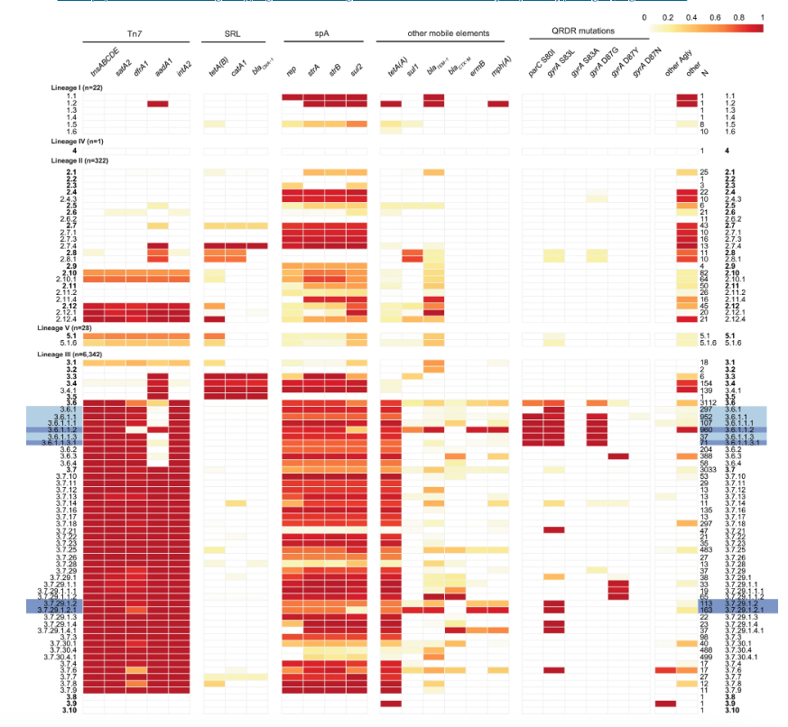
AMR plasmids
spA plasmid – mainly in lineage 3
AMR genes – tetA, sul2, aph(3'')-Ib,aph(6)-Id
similar plasmids reported in other bacterial family members
spA
Hawkey 2021 Nat Comms

Slide 5
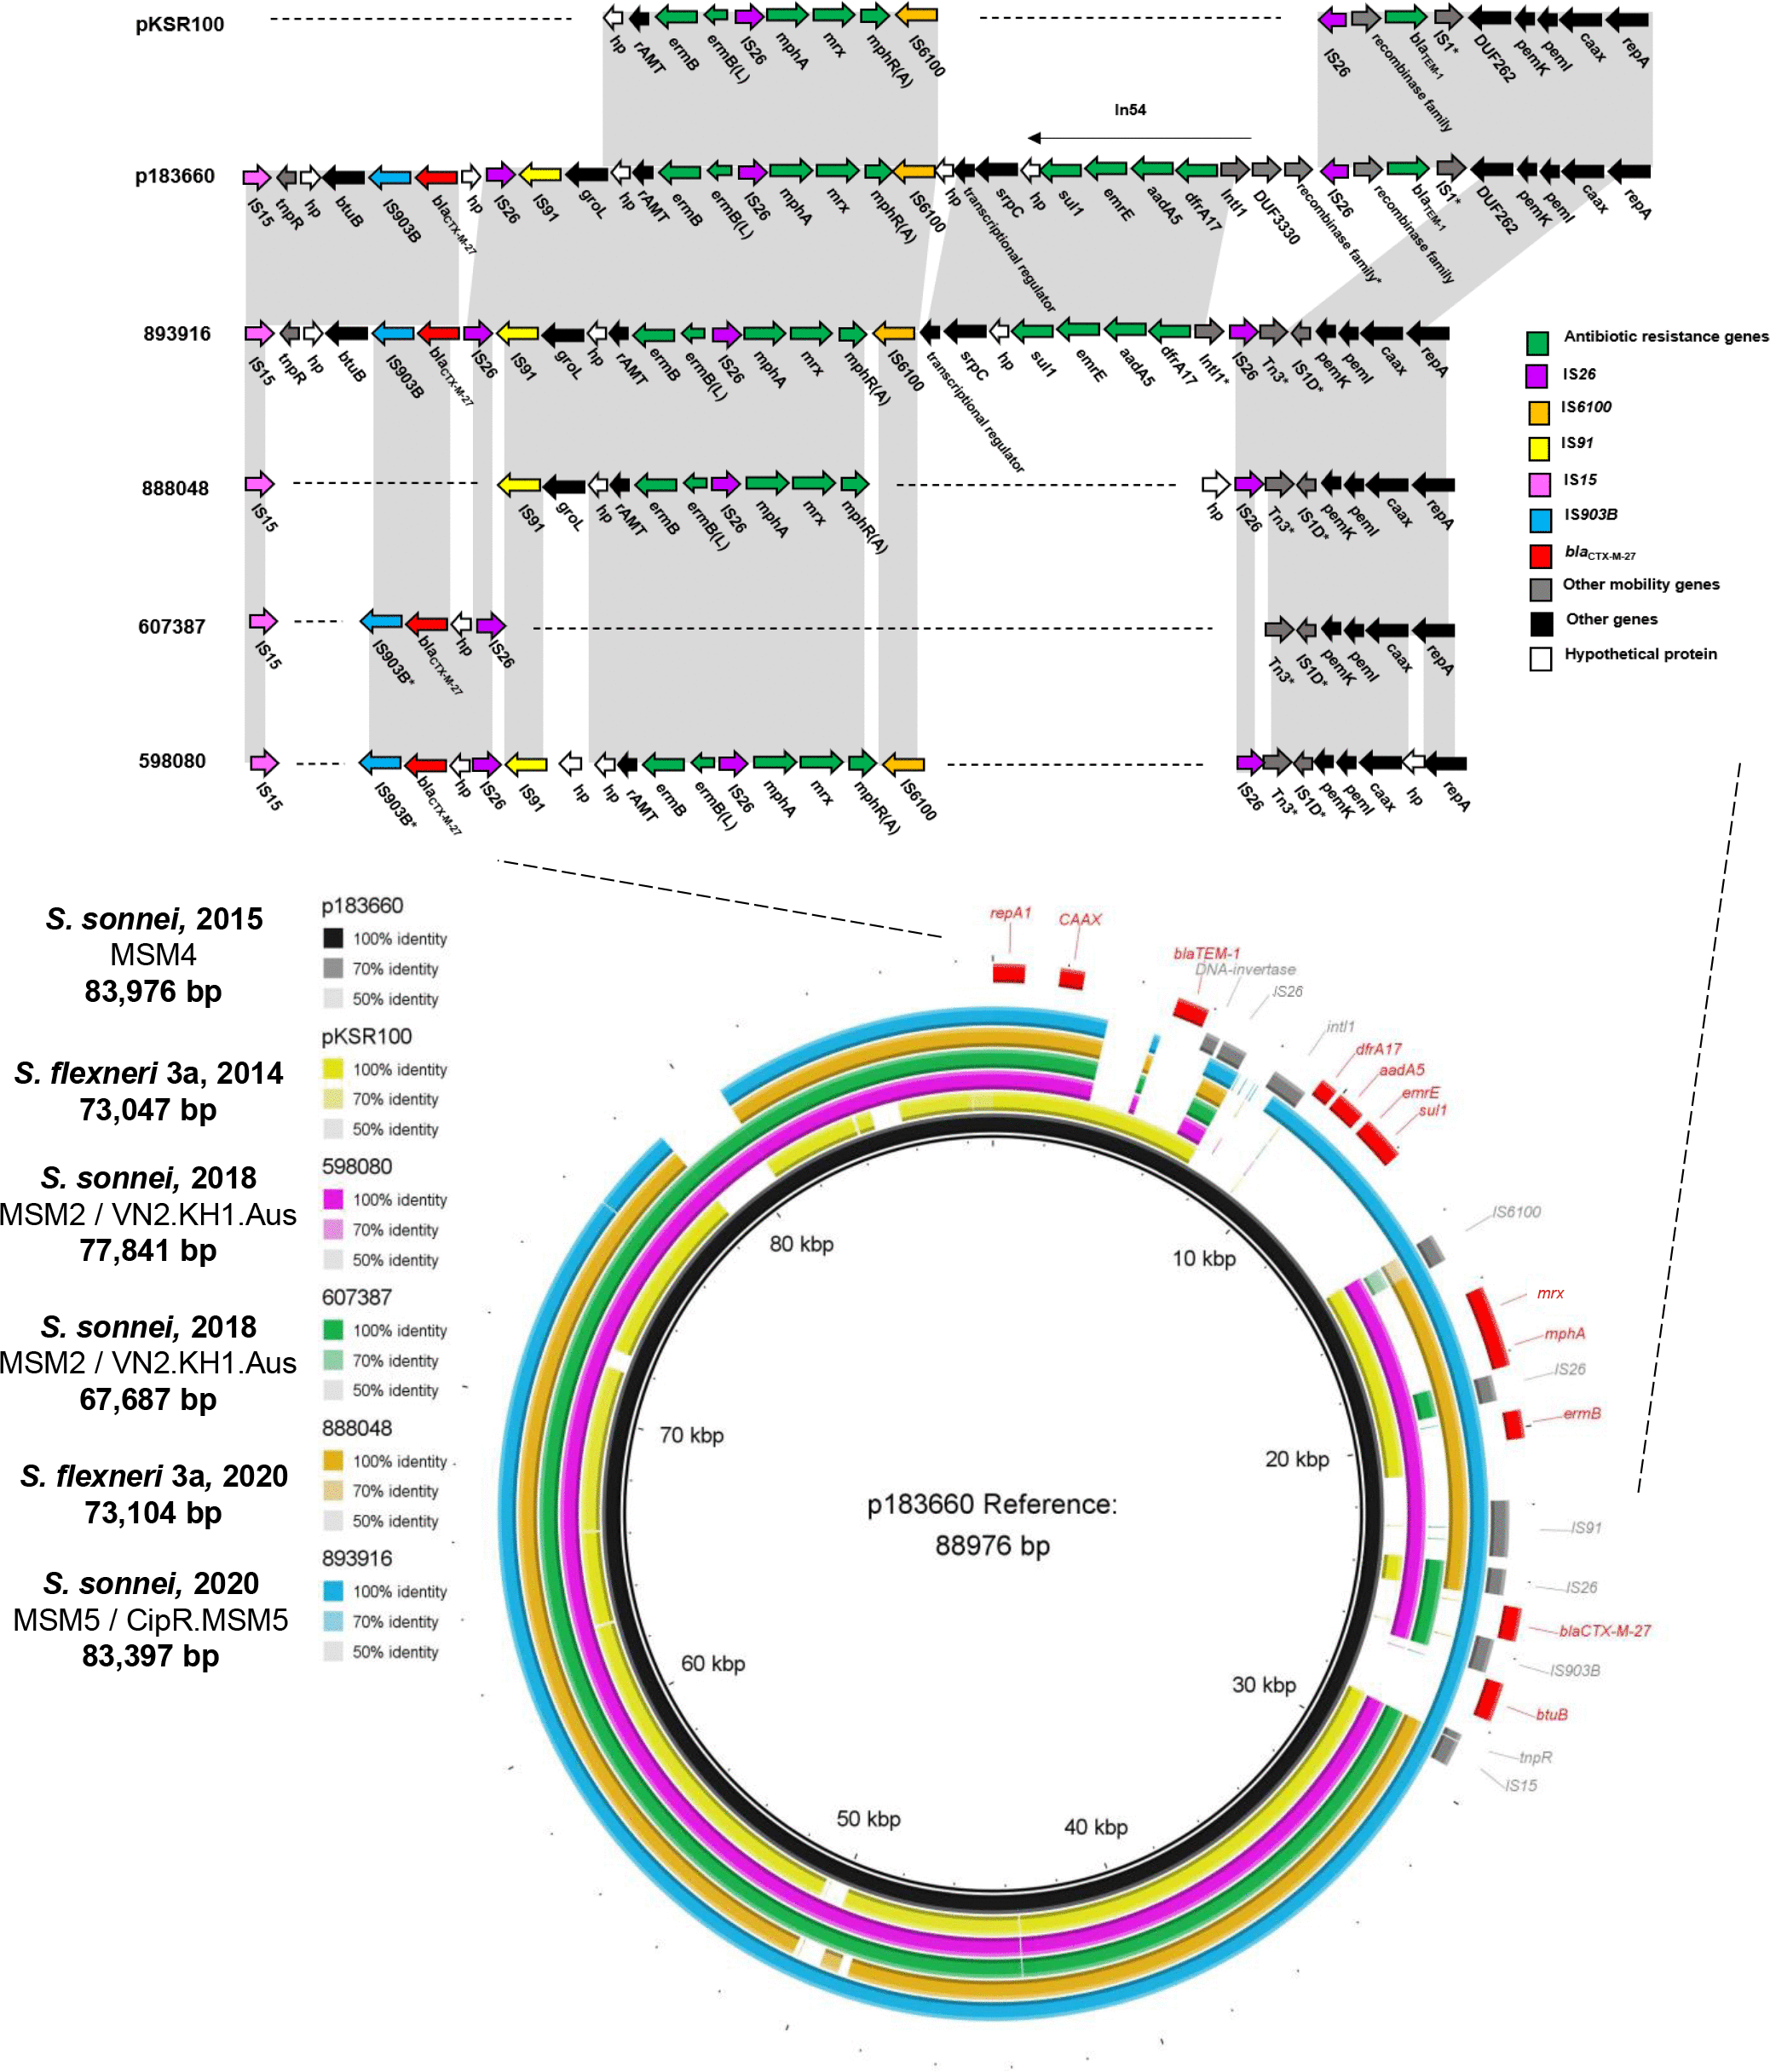
AMR plasmids
MDR plasmid – moving between lineages and species
Rep type – IncFIA. Predicted mobility – conjugative
blaTEM-1, erm(B)*,mph(A) (on reference).
dfrA17, aadA5, sul1 (pKSR100 integron)
Some picked up ctx-m genes as well
pKSR100
Locke 2021 MGen

Slide 6
Shigella epi background
Sampling proportion ~40-50% of notified cases to NNDSS
Consistent cases by sex and species. More M and sonnei. Expected
Consistent age brackets. Median 35 years (1st quartile 26 years, 3rd quartile 48 years)

Slide 7
Alignment to reference
Snippy + mask phage (phaster) + recombination (Gubbins)
S. sonnei (n = 789)
SNPs pre-recombination 100% = 7836
Post Gubbins (including Ns) = 11461
80% coreSNPfilter (no recomb) 11446
S. flexneri (n = 297)
SNPs pre-recombination 100% = 21742
Post Gubbins (including Ns ) = 31711
80% coreSNPfilter (no recomb) = 31307
S. flexneri + serotype 6 (n = 316)
SNPs pre-recombination 100% = 50685
Post Gubbins (including Ns) = 67671
Notes:
Past also then pulled SNP sites but think if can handle the Ns ok – better to go with the gubbins output

Slide 8
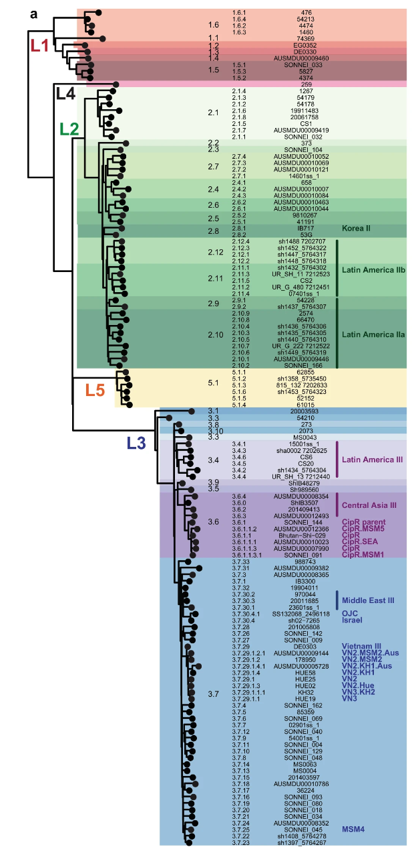
Sonnei + genotype + Year + CIP AMR
Overview – population
CIP resistance – point - core

Slide 9
Sonnei + genotype + plasmids
spA – in different sublineages of lineage 3.
spB – largely in lineage 2
spC – in three lineages + sublin
VP –detected but low coverage – lab culture issue
Notes:
3.7.3

Slide 10
Virulence plasmids – both species
Best alignment - 60% coverage of reference + 90 % core SNP filter

Slide 11
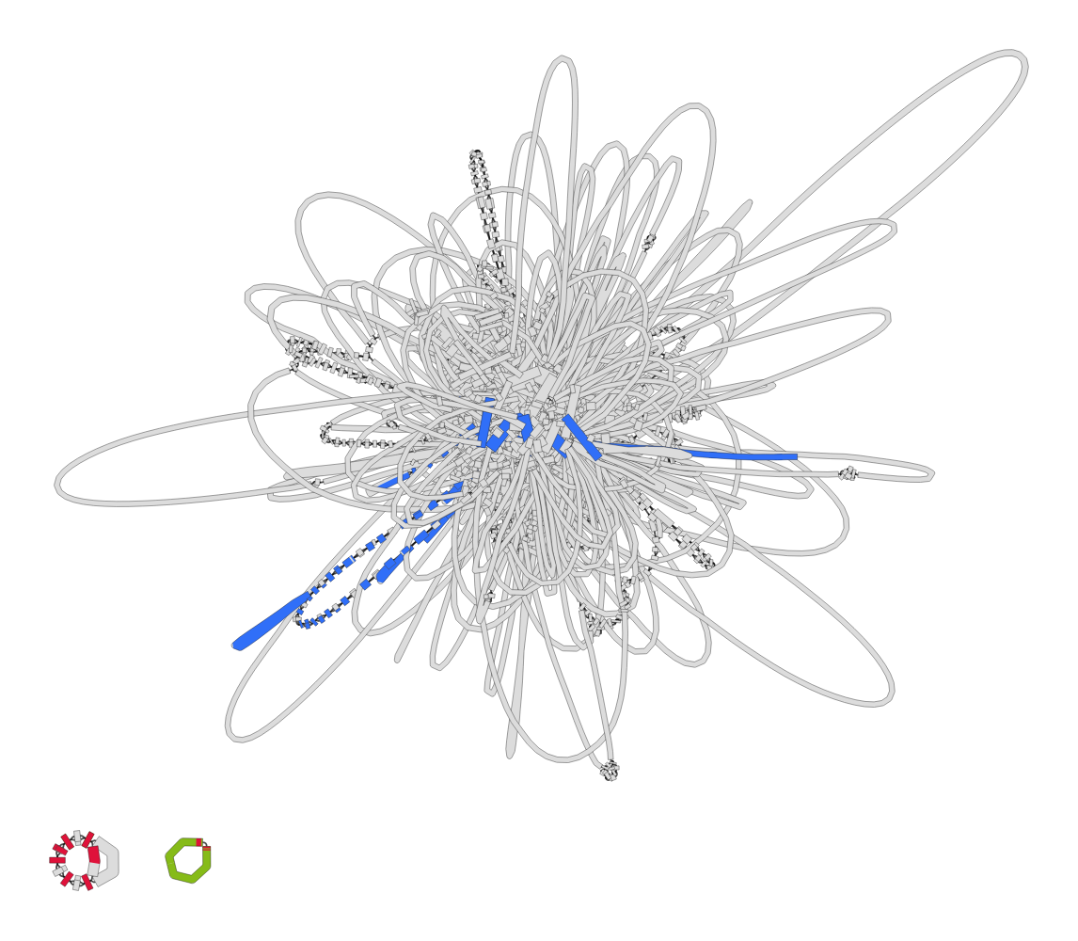
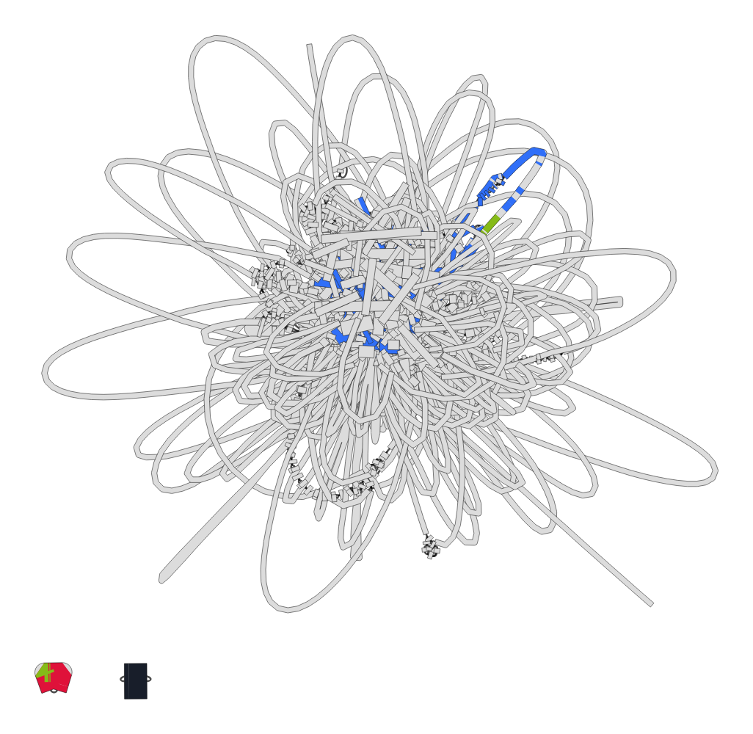
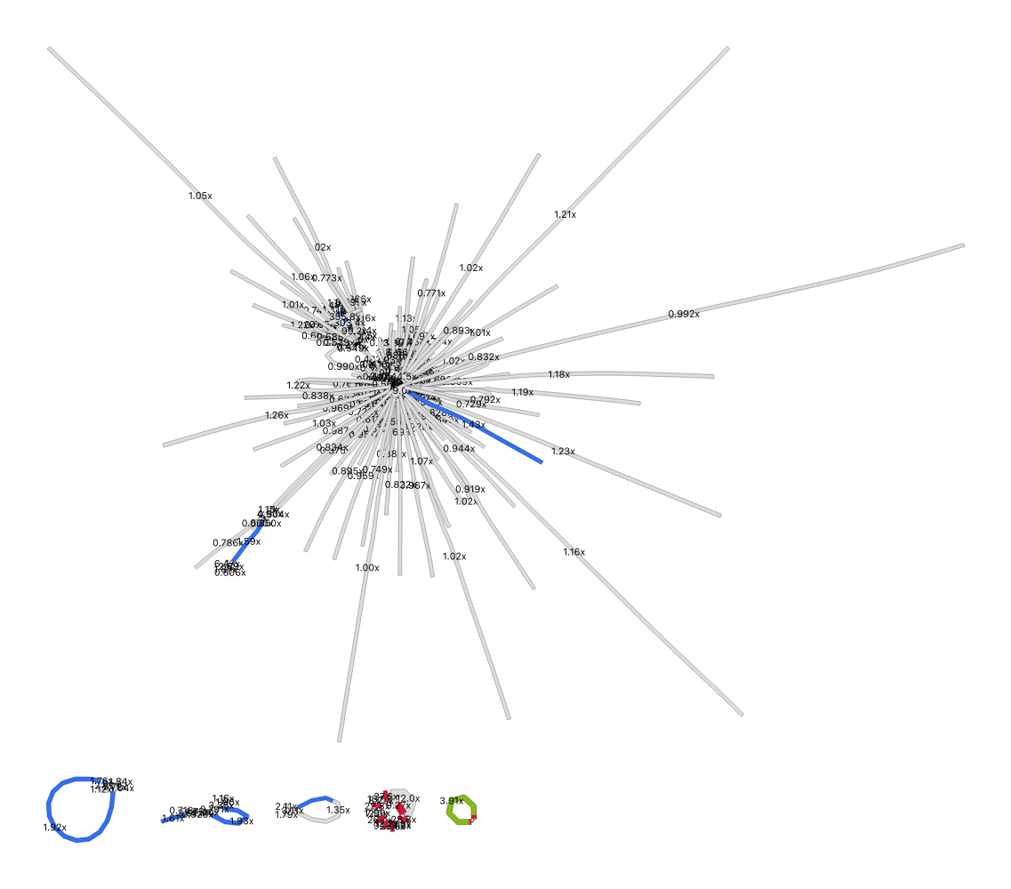
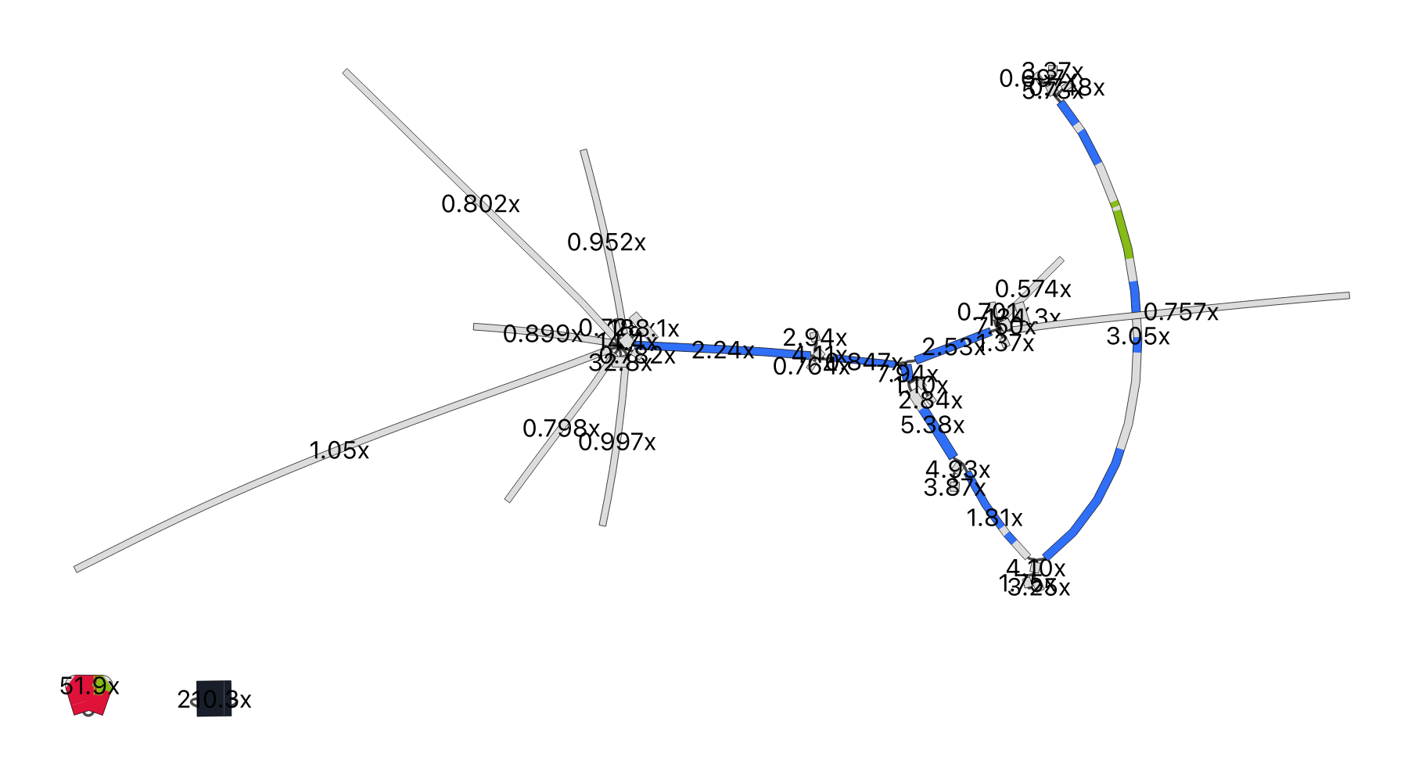
Sonnei + MDR plasmid
MDR and spA > 90
spB and spC > 90 MDR ~40-50%

Slide 12
MDR plasmid - pKSR100

Slide 13
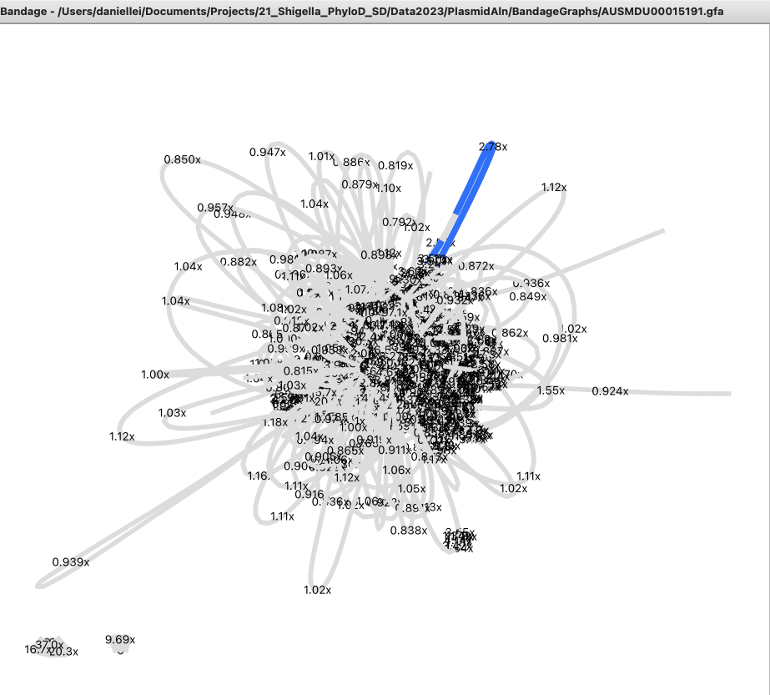
Flex + pKSR100 + MDR + graph + sero6

Slide 14
Small S. sonnei plasmids

Slide 15
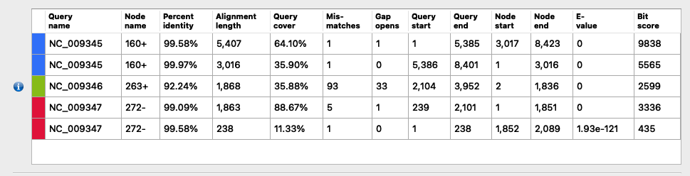
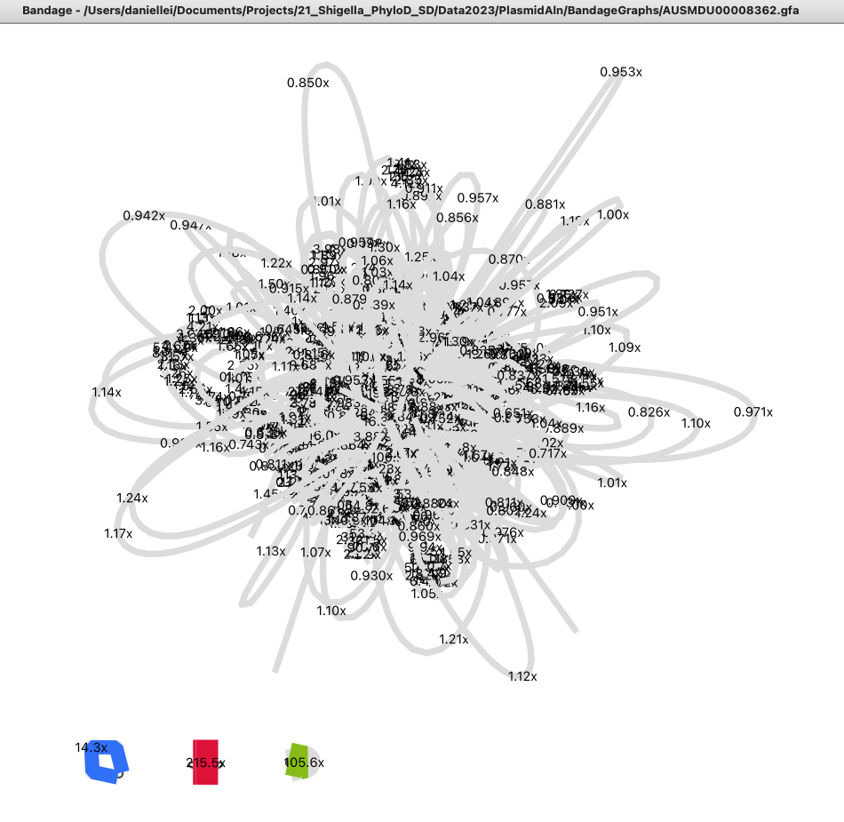
Sonnei + spA plasmid + AMR + graph

Slide 16
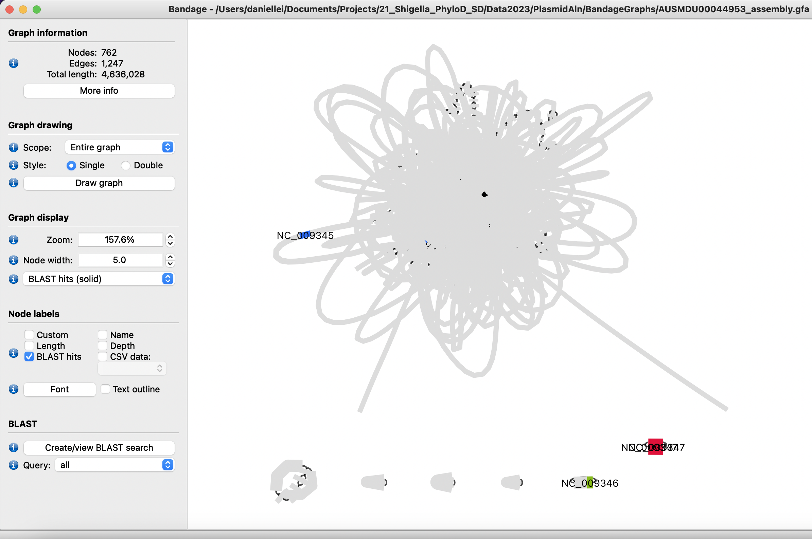
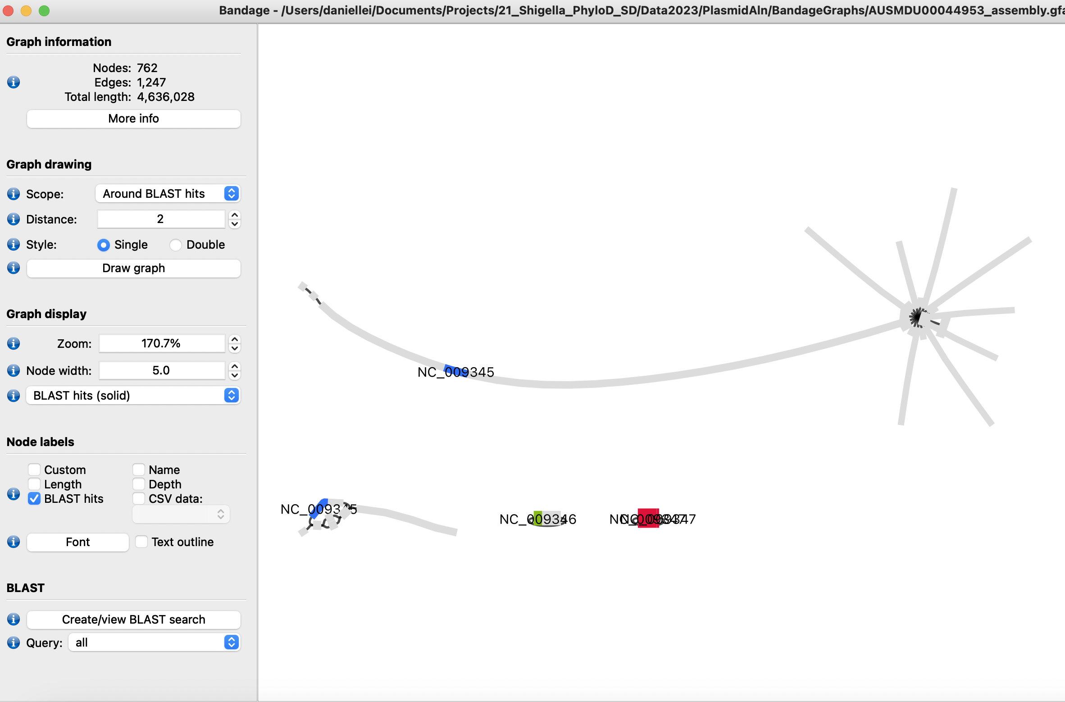
spA update
spA – 60-69% coverage of reference – in 3.7.29.1.4. Bandage visualization of assembly graphs - AUSMDU00044953

Slide 17
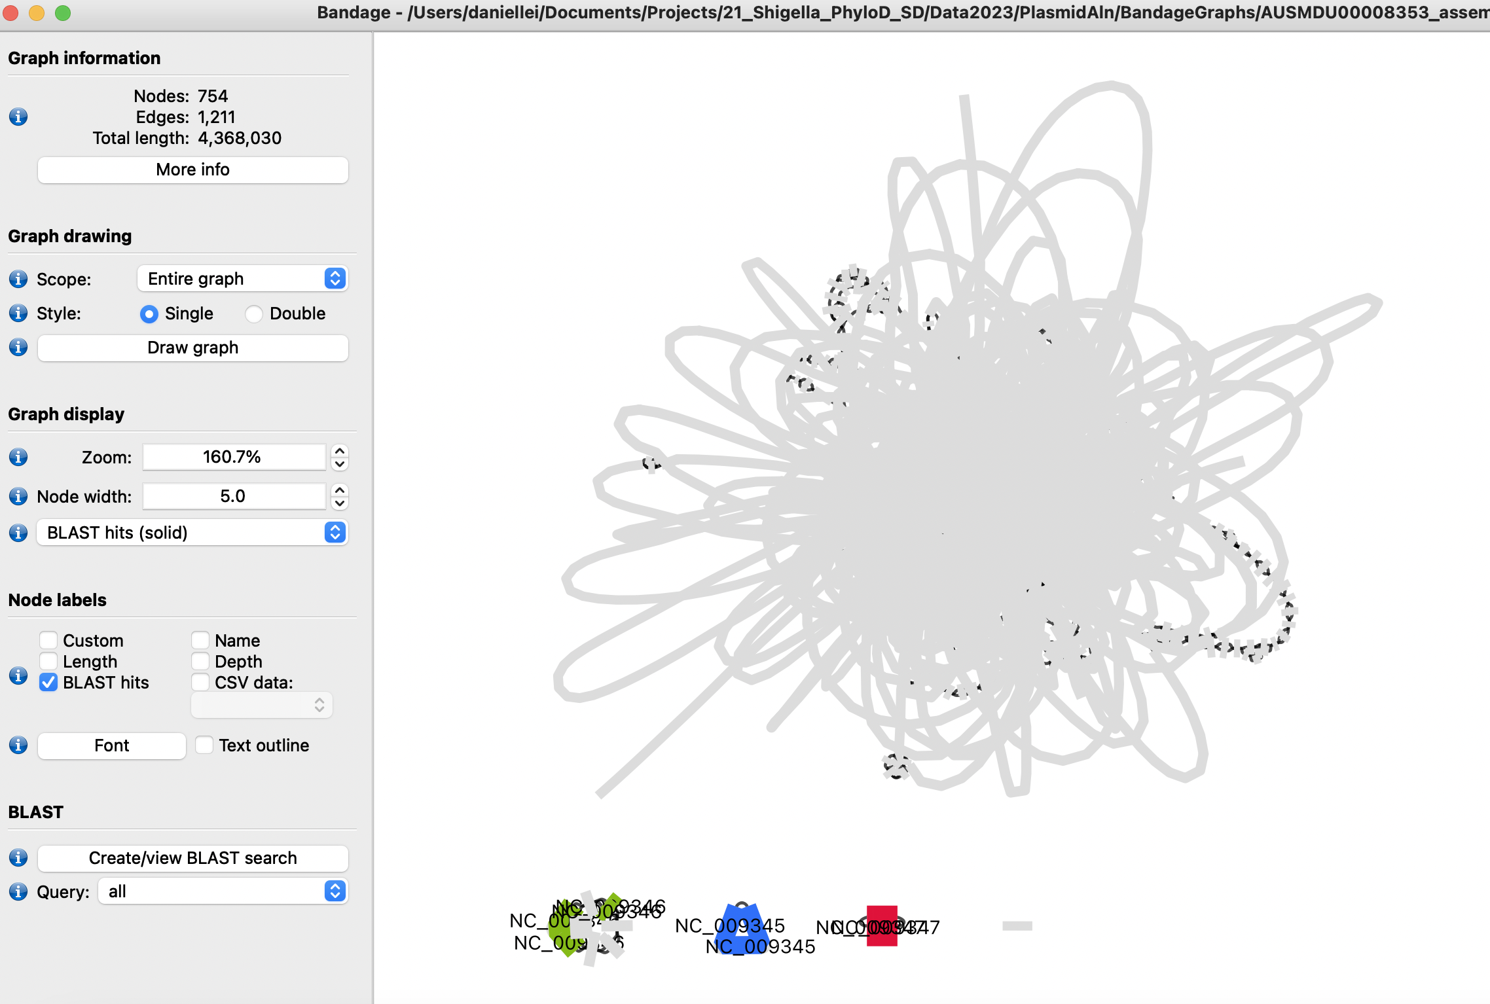
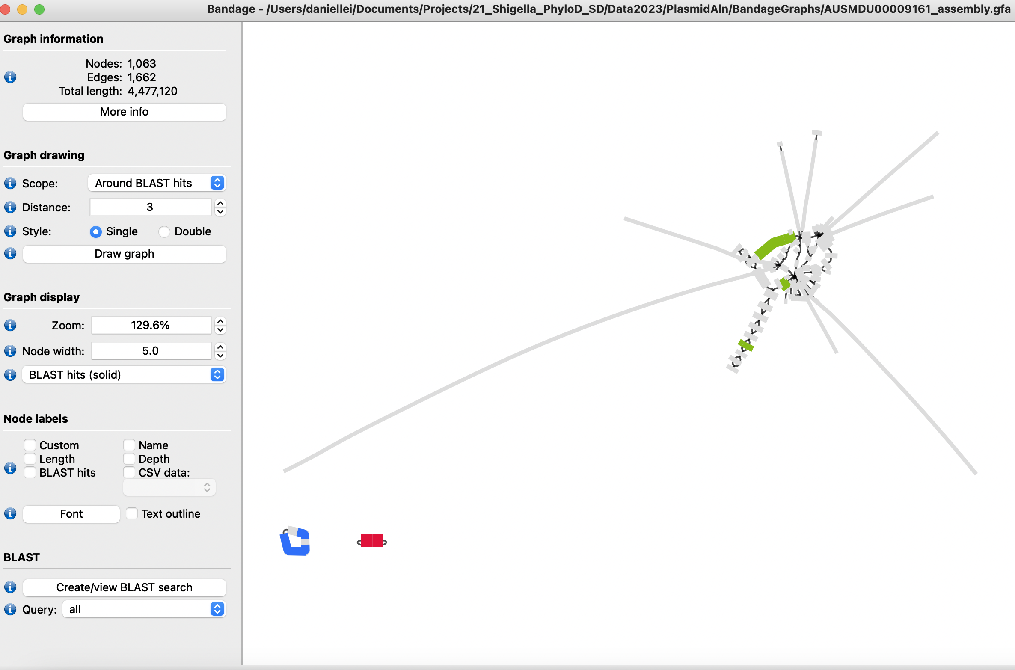
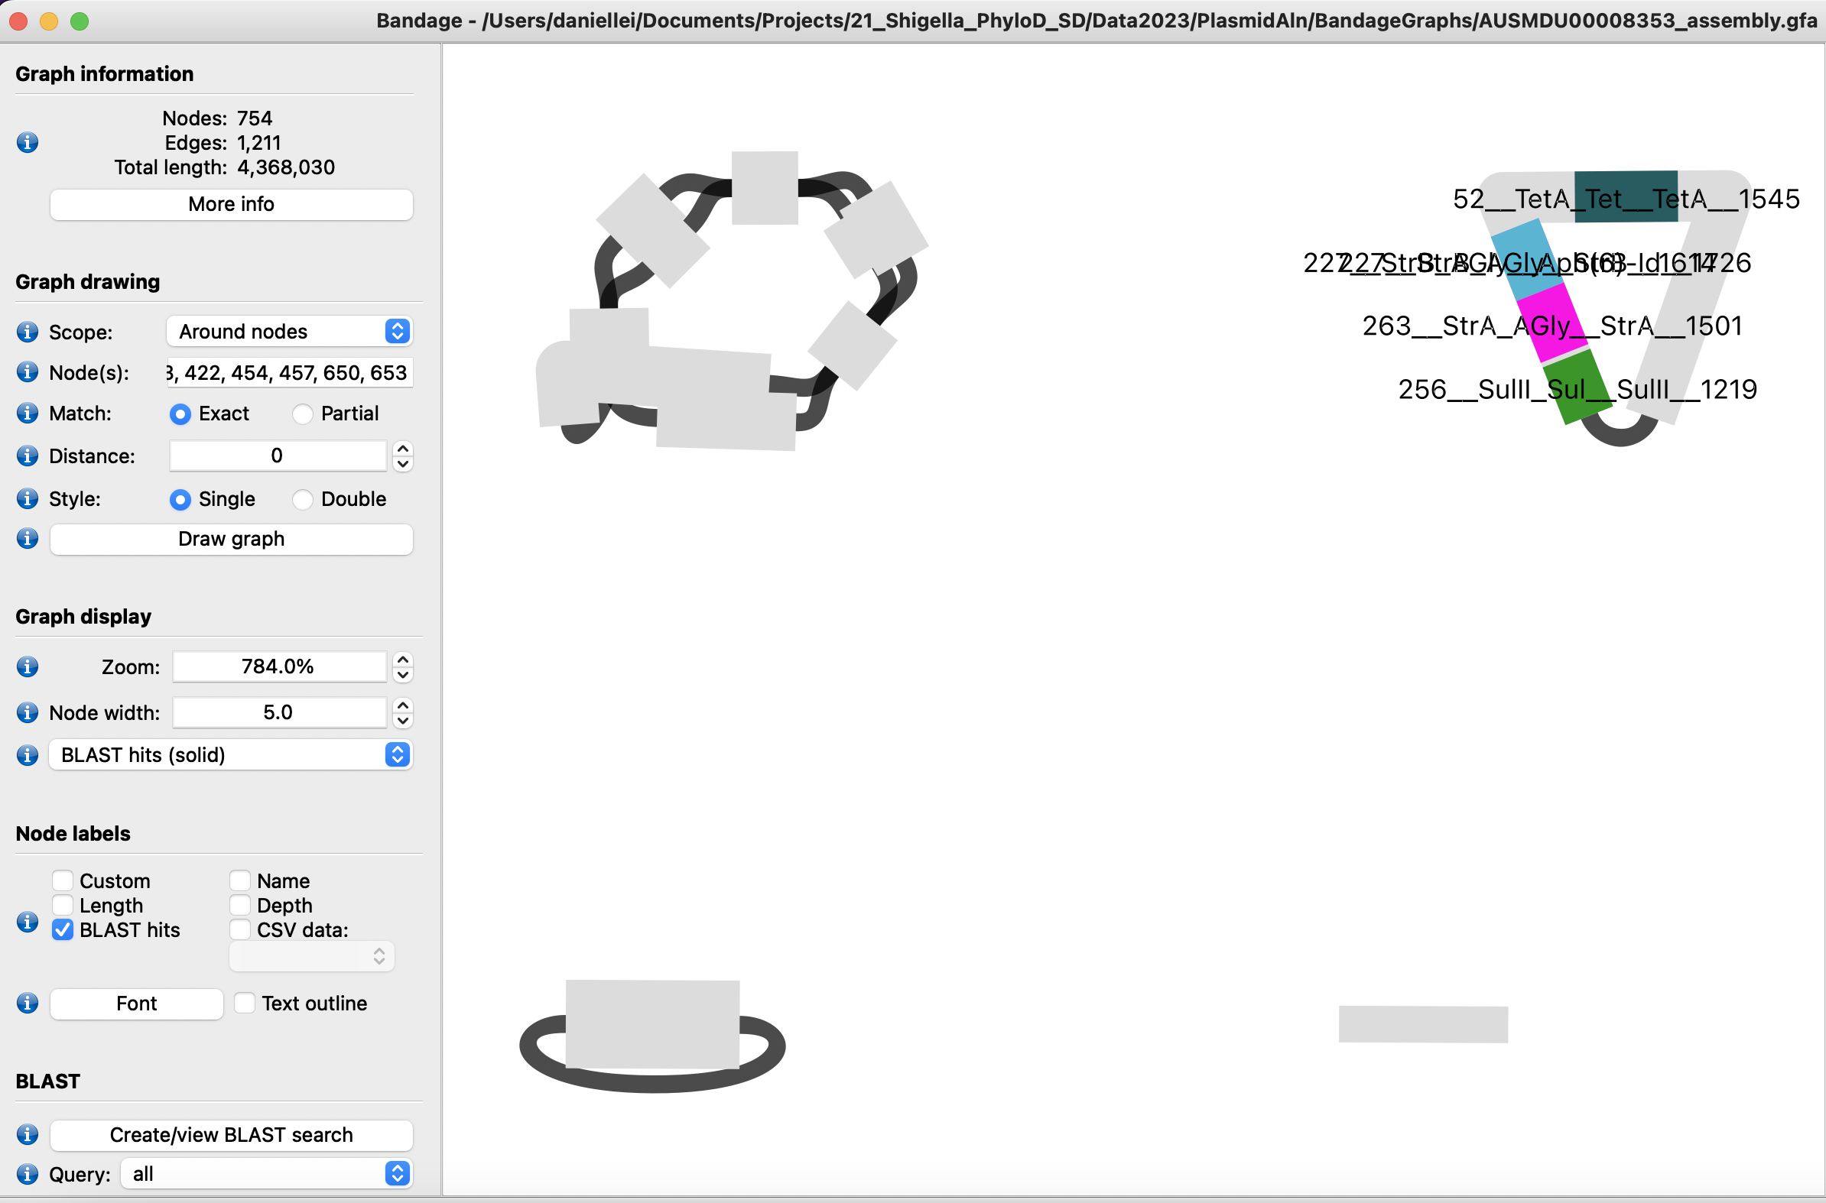
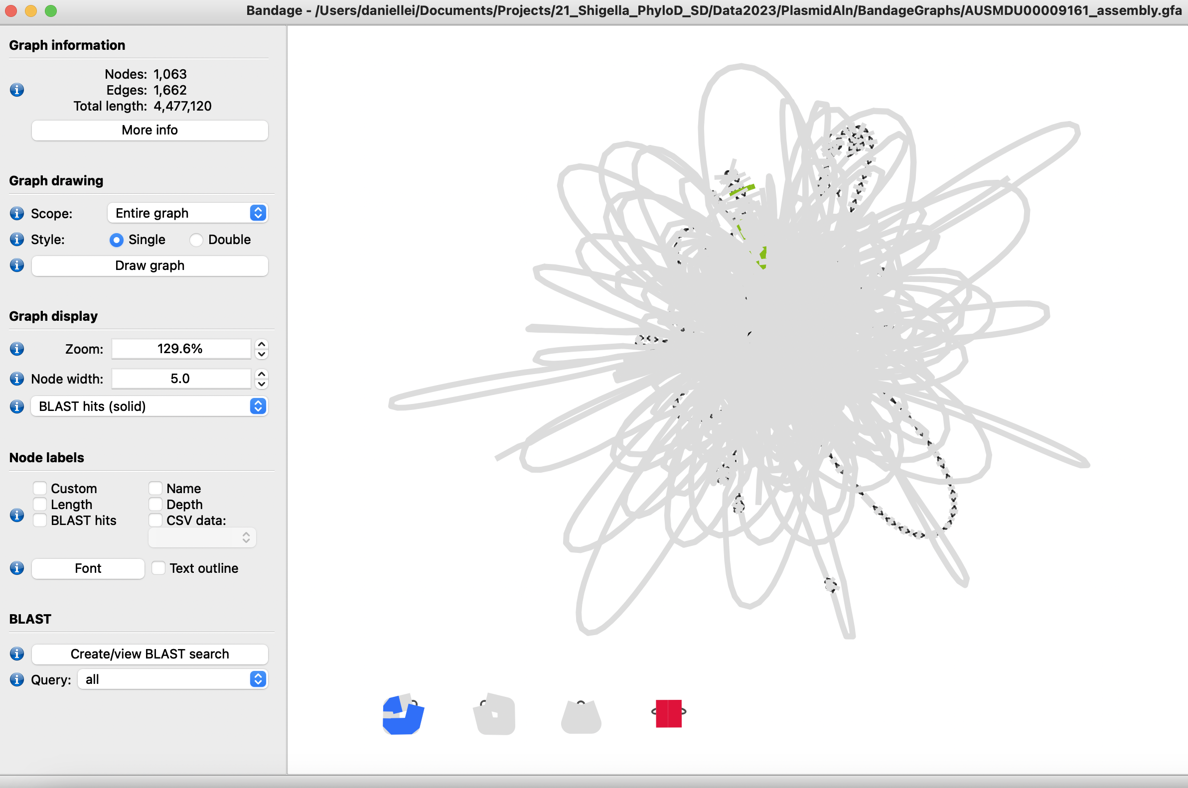
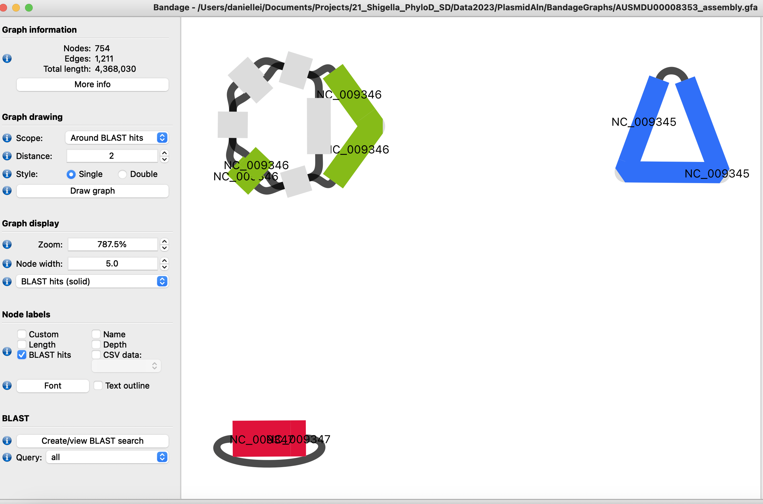
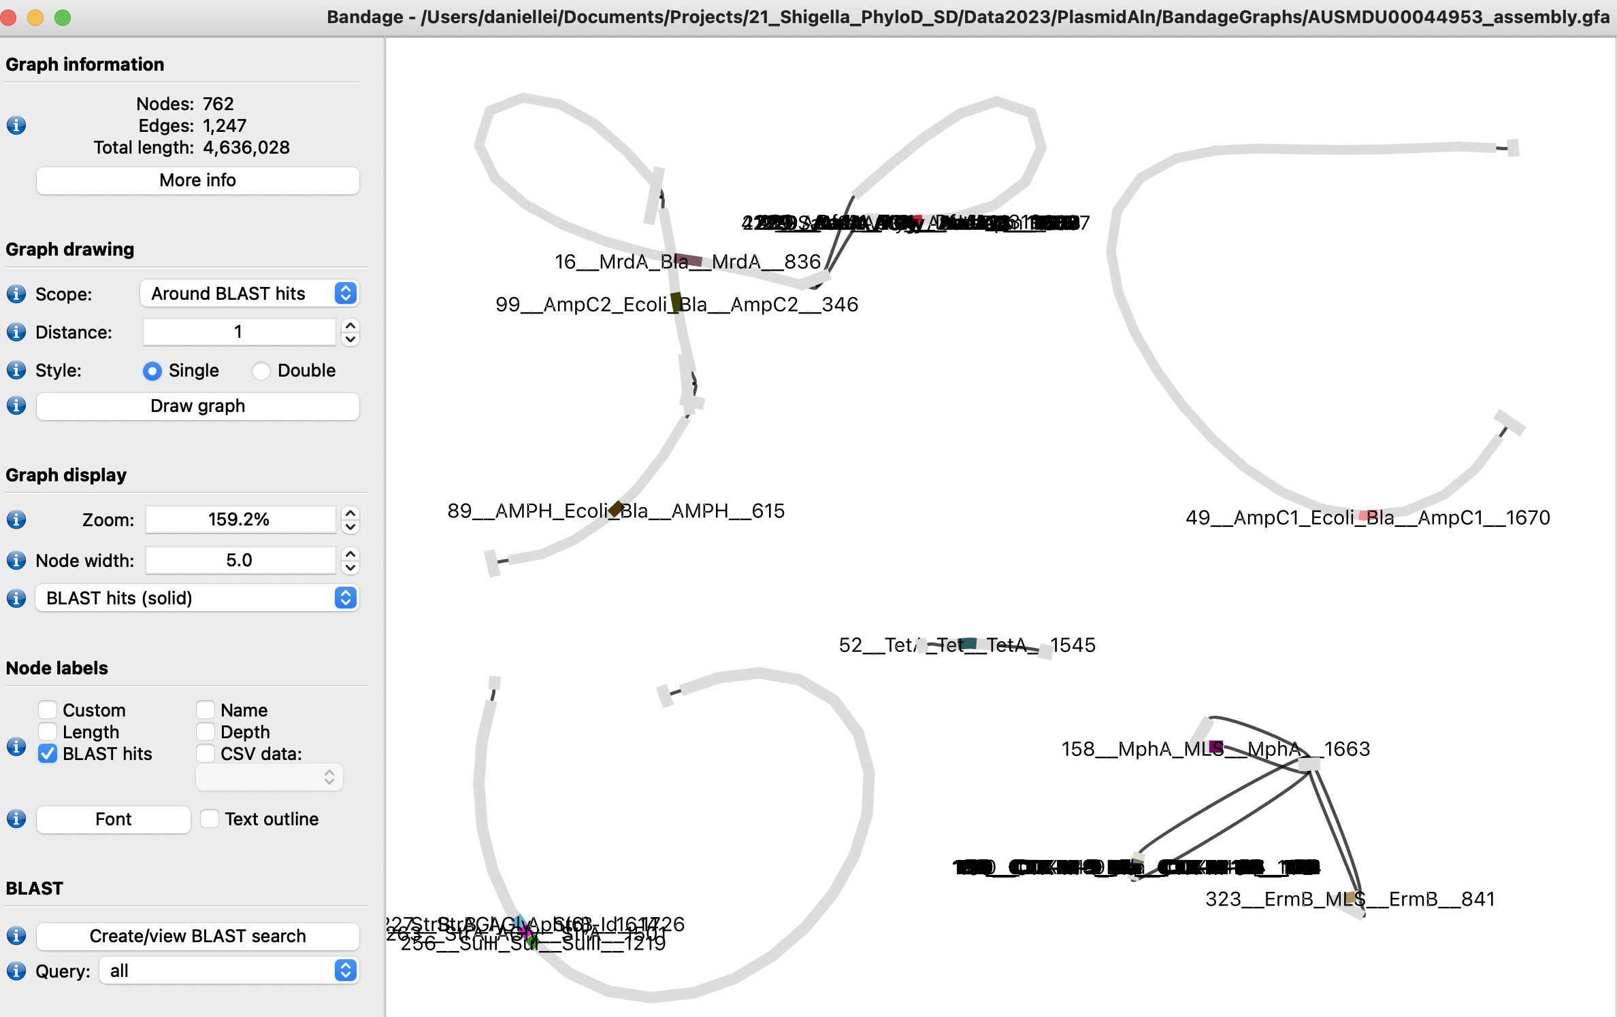
spA update
spA, spB and spC – 90% coverage of reference – in 3.7.3 Bandage visualization of assembly graphs - AUSMDU00008353
spA 70-79% spB and spC >90% coverage of reference – in 3.4.1 Bandage visualization of assembly graphs - AUSMDU00009161

